Slide 1
Tablets for SAISD High School Students
Steve Smith
By PresenterMedia.com

Slide 2

What is the problem?
San Antonio Independent School District scores ratings improving, but. . .
Year | Rating
2006 | Academically Acceptable
2007 | Academically Acceptable
2008 | Academically Acceptable
2009 | Academically Unacceptable
2010 | Academically Unacceptable
2011 | Academically Acceptable
2012 | No ratings assigned in 2011 (TEA, 2012)
Notes:
Texas Education Agency. (2012). Testing & accountability. Retrieved from http://www.tea.state.tx.us/index.aspx?id=2147495410&menu_id=660&menu_id2=795&cid=2147483660

Slide 3
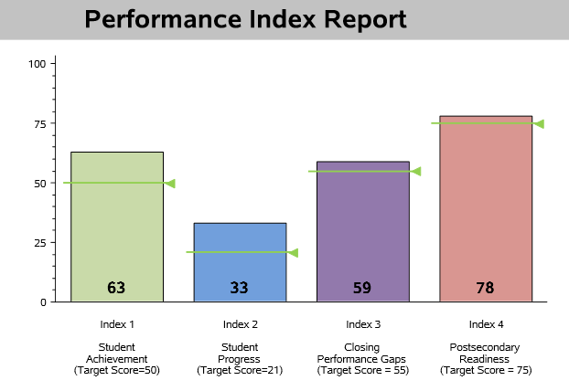
2013 Performance Index Report
. . . what more could be done? (TEA Division of Performance Reporting, 2013)
Notes:
TEA Division of Performance Reporting. (2013, August). 2013 Accountability summary. Retrieved from http://ritter.tea.state.tx.us/perfreport/account/2013/static/summary/district/d015907.pdf

Slide 4
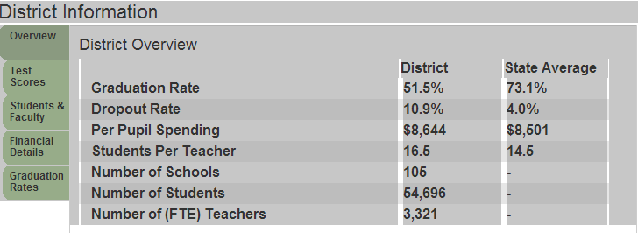
SAISD Overview
Is the district doing enough to address high drop out and low graduation rates? (LocalSchoolDirectory.com, 2014)
Notes:
LocalSchoolDirectory.com. (2014). San Antonio Independent School District. Retrieved from http://www.localschooldirectory.com/district-schools/015907/San-Antonio-Independent-School-District-(ISD)/TX

Slide 5
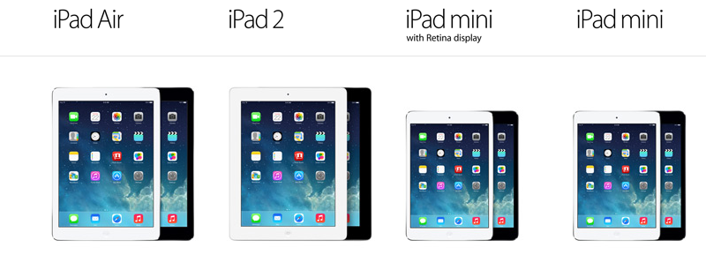
An idea. . .
Combine technology and innovative education (Apple, 2014)
Notes:
Apple.com. (2014). iPads [Image]. Retrieved from http://www.apple.com/ipad/

Slide 6
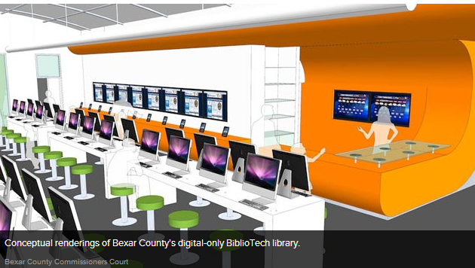
San Antonio’s BiblioTech
Increasing literacy through access to tablets (ABC News, 2013)
Notes:
ABC News. (2013, January 14). Conceptual renderings of Bexar County’s digital-only BiblioTech Library. Retrieved from http://abcnews.go.com/Technology/bookless-public-library-texas-home-bibliotech/story?id=18213091#.UZKyHIKjTQN

Slide 7
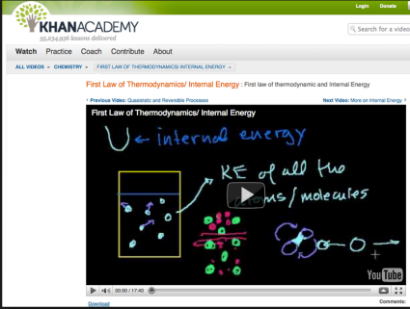
Khan Academy: The Next Generation
Giving students access to lectures, anytime, anywhere
Thousands of video lectures
Topics include
  Math
  Science
  Economics/finance
  World history
Partner with Museum of Modern Art (Khan Academy Library, 2014)
Notes:
Khan Academy screenshot [Image]. (2014). Salman Khan: Education to anyone, anywhere. Gilimag. Retrieved from http://gilimag.com/index.php?option=com_content&view=article&id=177:khan&catid=36:technology&Itemid=57
Khan Academy Library. (2014). Retrieved from https://www.khanacademy.org/library

Slide 8
What is a Flipped Classroom?
And what are the benefits?
Flipped
Traditional
Definition: Students review recorded lectures at home, do homework in class
Benefits:
Students can work at own pace and review material that confuses them.
Students take responsibility for their knowledge.
Students communicate with peers and teachers in online discussions as well as in class. (Knewton, 2014)
Definition: Classes are lecture-based, students do homework at home.
Concerns:
Little one-on-one interaction between students and teachers.
Students who get behind have difficulty catching up because they do not understand concepts needed to move forward.
Is the traditional classroom working for SAISD students?
Notes:
Knewton.org. (2014). The flipped classroom. Retrieved from http://www.knewton.com/flipped-classroom/

Slide 9
Minnesota Experiments with Math
Byron ISD flips the math classroom
Abandoned textbooks and created own math curriculum
Used free Moodle platform
Created video tutorials to replace lectures
Used “flipped” classroom approach in many classes
Found students in flipped classes scored higher on chapter tests than those in traditional classrooms after 2.5 years (Fulton, 2013)

Slide 10
Concerns
What can we learn from others’ mistakes?
Late 1990s study commissioned by President Clinton could not conclude that technology improves outcomes; recommended integrating technology anyway (Reich, 2012)
Los Angeles tablet program had students hacking tablets to access non-approved sites (Catalano, 2013)
Guilford County, NC middle school tablet experiment cost $30 million, but many tablets had hardware malfunctions and broken screens (Catalano, 2013)

Slide 11
A plan of action:
Addressing cost and pedagogical concerns
Combine technology with a pedagogical approach like the “flipped classroom”
Choose technology carefully (iPad, Android, Chromebook)
Partner with technology providers and local businesses to reduce costs and receive guidance

Slide 12
References
ABC News. (2013, January 14). Conceptual renderings of Bexar County’s digital-only BiblioTech Library. Retrieved from http://abcnews.go.com/Technology/bookless-public-library-texas-home-bibliotech/story?id=18213091#.UZKyHIKjTQN.
Apple.com. (2014). iPads [Image]. Retrieved from http://www.apple.com/ipad/.
Catalano, F. (2013, October 9). Tech happens: When tablets and schools don’t mix. GeekWire. Retrieved from http://www.geekwire.com/2013/tech-tablets-schools-mix/.

Slide 13
References
Fulton, K. (2013). Byron’s flipped classrooms. Education Digest, 79(1), 22–26.
Khan Academy Library. (2014). Retrieved from https://www.khanacademy.org/library.
Khan Academy screenshot [Image]. (2014). Salman Khan: Education to anyone, anywhere. Gilimag. Retrieved from http://gilimag.com/index.php?option=com_content&view=article&id=177:khan&catid=36:technology&Itemid=57.

Slide 14
References
Fulton, K. (2013). Byron’s flipped classrooms. Education Digest, 79(1), 22–26.
Khan Academy screenshot [Image]. (2014). Salman Khan: Education to anyone, anywhere. Gilimag. Retrieved from http://gilimag.com/index.php?option=com_content&view=article&id=177:khan&catid=36:technology&Itemid=57.
Khan Academy Library. (2014). Retrieved from https://www.khanacademy.org/library.

Slide 15
References
Knewton.org. (2014). The flipped classroom. Retrieved from http://www.knewton.com/flipped-classroom/.
LocalSchoolDirectory.com. (2014). San Antonio Independent School District. Retrieved from http://www.localschooldirectory.com/district-schools/015907/San-Antonio-Independent-School-District-(ISD)/TX.
Reich, J. (2012, July 5). Technology is not a silver bullet [Blog post]. Education Week. Retrieved from http://blogs.edweek.org/edweek/edtechresearcher/2012/07/technology_is_not_a_silver_bullet.html.

Slide 16
References
TEA Division of Performance Reporting. (2013, August). 2013 Accountability summary. Retrieved from http://ritter.tea.state.tx.us/perfreport/account/2013/static/summary/district/d015907.pdf.
Texas Education Agency. (2012). Testing & accountability. Retrieved from http://www.tea.state.tx.us/index.aspx?id=2147495410&menu_id=660&menu_id2=795&cid=2147483660.

